Slide 1

STATISTICS PROGRAM
CEMSE Division
https://cemse.kaust.edu.sa/stat

Slide 2
Degrees and Opportunities
M.S. in Statistics
            Statistical Science Track
        Data Science Track
Ph.D. in Statistics
Various Intern/Summer Research Opportunities

Slide 3
Why Statistics
            Weather forecast
            Self-driving cars
            Protein design
        ChatGPT/Gemini
        Estimation of health risk and impact of factors on this risk
        …
Statistics training offers the mathematical tools to quantify uncertainty and estimating effects of various factors.

Slide 4
Demand for Statistics
High demand for statisticians and data scientists in academia, government and industry (tech, finance, marketing, health, etc.)
Opportunities in Saudi Arabia
  Health and Wellness
  Energy
  Environment
  Agriculture
  Artificial Intelligence
  Research

Slide 5
Best Preparation
Undergraduate majors
        Mathematics (mixed with Applied), Statistics/Physics/Computer Science/Electrical Engineering
Courses
  Math: Caculus, Linear Algebra, Measure theory
  Computing: Optimization, Numerical Methods, R/C++/Python
  Statistics: Statistical testing, Bayesian Inference, Regression Methods, Simulations
  AVOID classes that focus merely on using statistical software

Slide 6

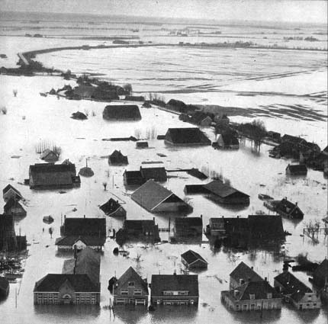
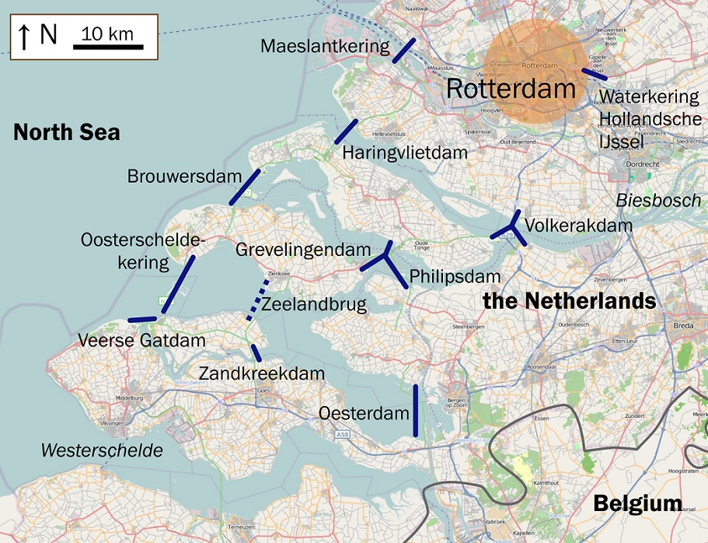
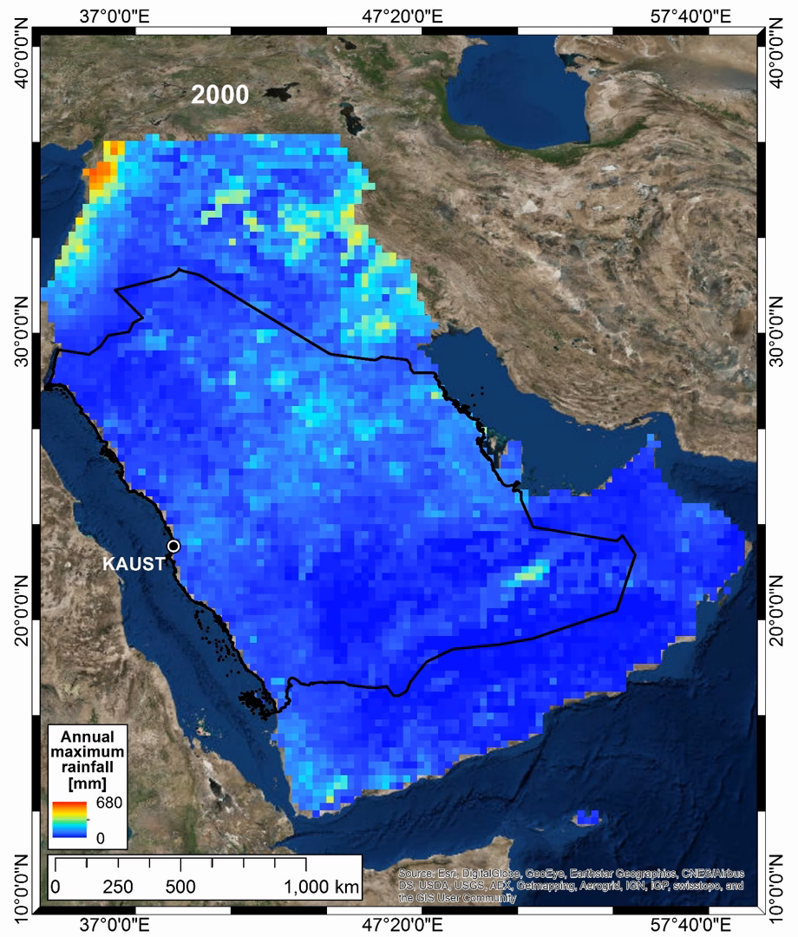
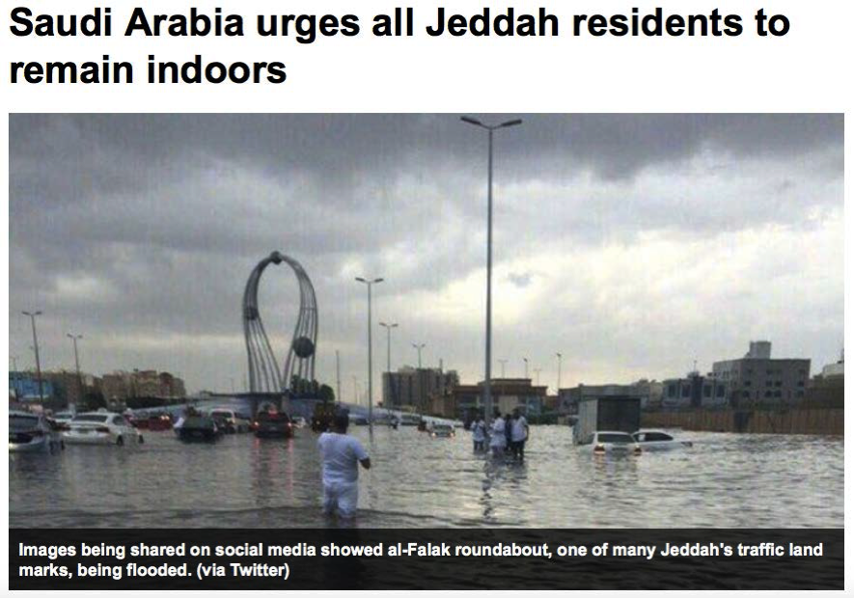
STATISTICS FOR EXTREME EVENTS
Prof. Raphael Huser
Notes:
Extreme events are everywhere. They affect us as a society, they affect the economy and the environment.
But what are exactly extreme events? How are they defined? How can we analyze them statistically? How can we predict them? And why is it so challenging to make such predictions?
Extreme events, by definition, are rare events. In other words, they occur with very low probability. They do not occur frequently, but when they do (and they WILL), they might have dramatic consequences. And that’s why we should care about the modeling of these extreme events.
To give you a concrete example, please have a look at the pictures on this slide, especially the one on the bottom right. This article, taken from a local newspaper, talks about a flood to hit the city of Jeddah in November 2015. All Jeddah residents were urgent to remain indoors because of this extremely intense rainfall event. On the left hand side you can see an animation displaying annual maximum rainfall data for the Arabic Peninsula from 1998 to 2014. So the question that we may ask if whether the 2015 Jeddah flood could actually be predicted from the data on the left. Or stated otherwise: what was the probability of the 2015 Jeddah flood based on the data available so far? THIS IS statistics of extremes.
So what are the challenges related to predicting such future extreme events? A good illustration can be given with the North Sea flood of 1953, illustrated with the two other pictures on the slide. Let me tell you the story. On the night of Jan 31-Feb 1, 1953, a combination of a high spring tide and a severe European windstorm caused a storm tide in the North Sea. The water level locally exceeded 5.6 meters above mean sea level. The flood and waves overwhelmed sea defenses and caused extensive flooding resulting in more than 2000 fatalities. So the Dutch government set up the so-called Delta commission, which conceived and deployed an ambitious flood defense system, called the Delta works, designed to protect the estuaries of the rivers Rhine, Meuse and Schedlt. But they had to face a compromise between cost and safety. Because when you build a dam, when it’s too low it’s unsafe, and when it’s too high it’s too expensive. So the Delta commission decided to set the risk according to region. For instance, in North Holland, the flood defenses were built to resist against a failure at 1 in 10000 years! However, such risk assessment had to be based on observed data available on a much shorter period! And this underlies two main challenges with the modeling of extremes: One is that we have a lack of data. We don’t have so many extreme events in our dataset. The other challenge is that we need to extrapolate to events that we haven’t observed in the past. And we need to do this extrapolation in a reliable and rigorous way. That’s why statistics of extremes, which is based on extreme-value theory, is useful. It provides models and statistical methods that can be mathematically justified to do such extrapolations.
<number>

Slide 7
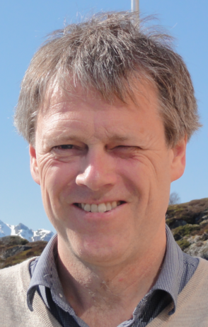
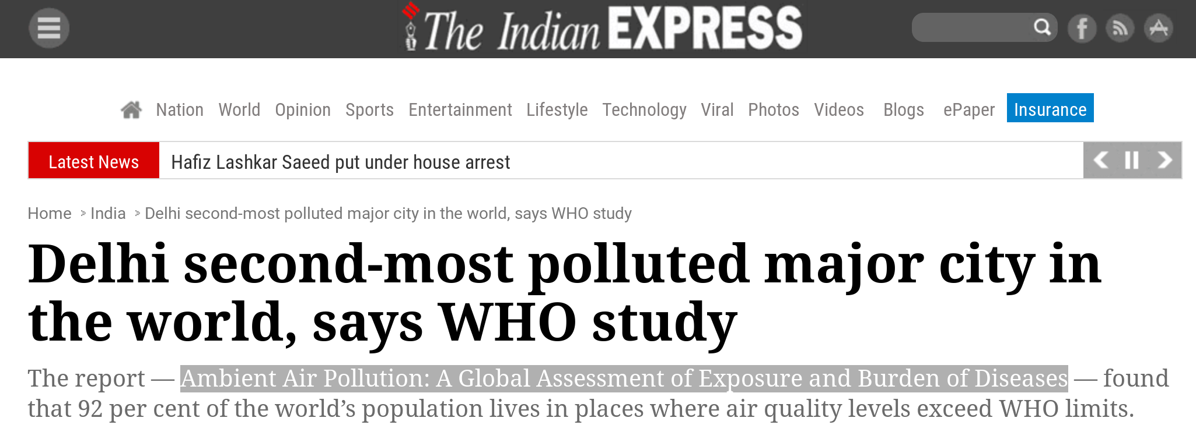


R-INLA: A TOOL FOR BAYESIAN STATISTICS
Prof. Haavard Rue Bayesian Computational Statistics & Modeling Group
In this research group, we develop methods and software for doing Bayesian inference for latent Gaussian models, which are widely used by researchers in applied sciences all around the world!
A lot of statistical models are almost Gaussian and this is what we make use of
Notes:
The picture on the bottom right shows the extent of the flood that hit KAUST in 2009. One main feature of this extreme event is that it was more extreme than ever recorded in the past in this region, and thus, was unexpected at KAUST. This specific example illustrates the general need to develop statistical models that can predict the probability of future extremes reaching previously unobserved levels. Similarly, the prediction of extremely low rainfall levels is of high importance to assess the risk of droughts (picture on the bottom left). The difficulty of the task resides in the vital need to base any such future extrapolations on theoretically justified arguments, but also in the lack of extreme data (they scarce by definition!), and in the typically highly complex nature of the phenomenon (possibly high-dimensional, spatially correlated, likely non-stationary, etc.). In this work, we propose to a joint model for low, moderate and high rainfall intensities, which does not focus on the largest (or lowest) observations only, but combines all the data into a global model, in order to increase the precision of our parameter estimates, and provide better risk assessment. We showed that the proposed models are not only simple, but can fit very well in practice (figure in the middle).
Naveau, Huser, Ribereau, Hannart (2016, to appear) Modelling jointly low, moderate and heavy rainfall intensities without a threshold selection, Water Resources Research
<number>

Slide 8


BIOSTATISTICS
Prof. Hernando Ombao
https://biostats.kaust.edu.sa
Genetics Brain Signals Behavior
Environment Time Series Disease/Treatment Response
Notes:
The picture on the bottom right shows the extent of the flood that hit KAUST in 2009. One main feature of this extreme event is that it was more extreme than ever recorded in the past in this region, and thus, was unexpected at KAUST. This specific example illustrates the general need to develop statistical models that can predict the probability of future extremes reaching previously unobserved levels. Similarly, the prediction of extremely low rainfall levels is of high importance to assess the risk of droughts (picture on the bottom left). The difficulty of the task resides in the vital need to base any such future extrapolations on theoretically justified arguments, but also in the lack of extreme data (they scarce by definition!), and in the typically highly complex nature of the phenomenon (possibly high-dimensional, spatially correlated, likely non-stationary, etc.). In this work, we propose to a joint model for low, moderate and high rainfall intensities, which does not focus on the largest (or lowest) observations only, but combines all the data into a global model, in order to increase the precision of our parameter estimates, and provide better risk assessment. We showed that the proposed models are not only simple, but can fit very well in practice (figure in the middle).
Naveau, Huser, Ribereau, Hannart (2016, to appear) Modelling jointly low, moderate and heavy rainfall intensities without a threshold selection, Water Resources Research
<number>

Slide 9
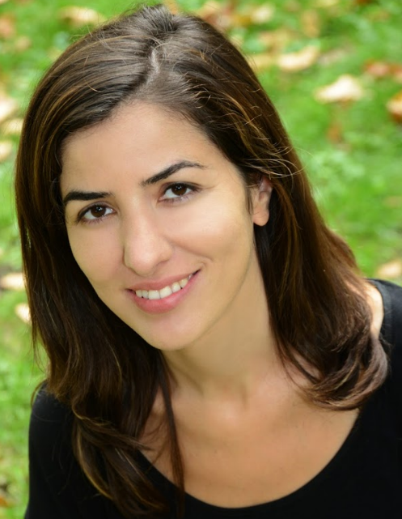
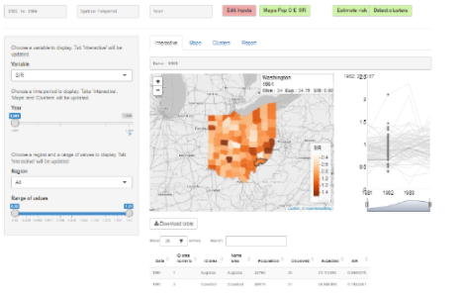
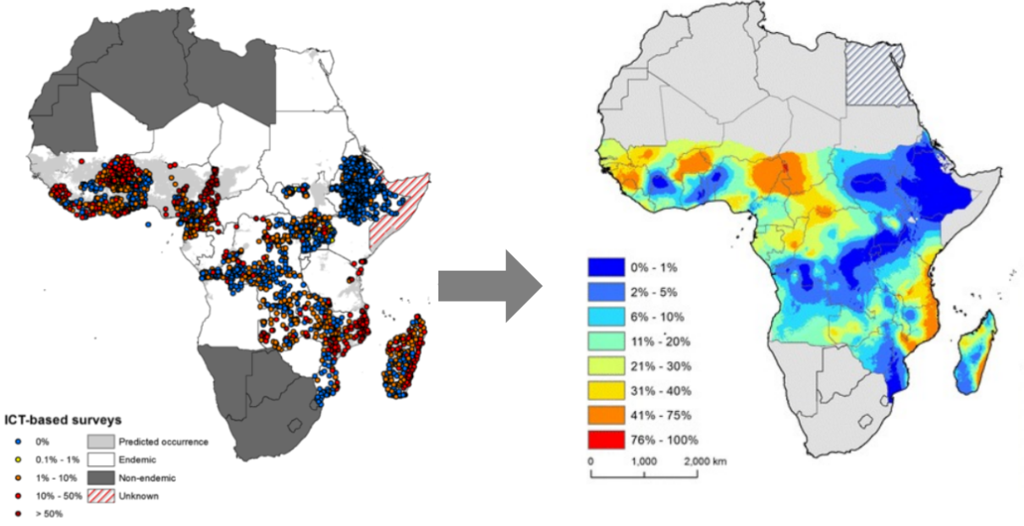
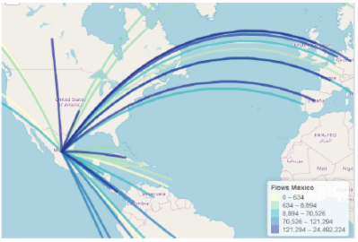
Geospatial Statistics & Health Surveillance
Prof. Paula Moraga www.paulamoraga.com
SpatialEpiApp: spatial modeling & visualization
Disease mapping, detection of clusters, early detection of disease outbreaks
Statistical software, interactive visualization applications to facilitate communication and inform policymaking
Geostatistical models to predict disease risk and identify risk factors
epiflows: travel-related spread of disease
Notes:
<number>

Slide 10

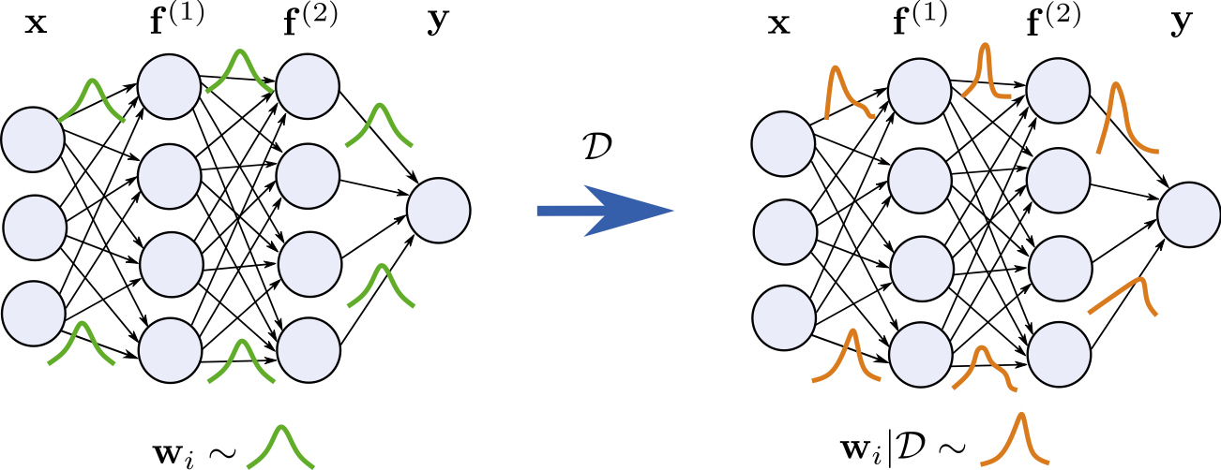
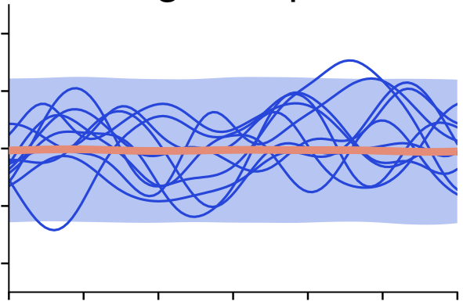
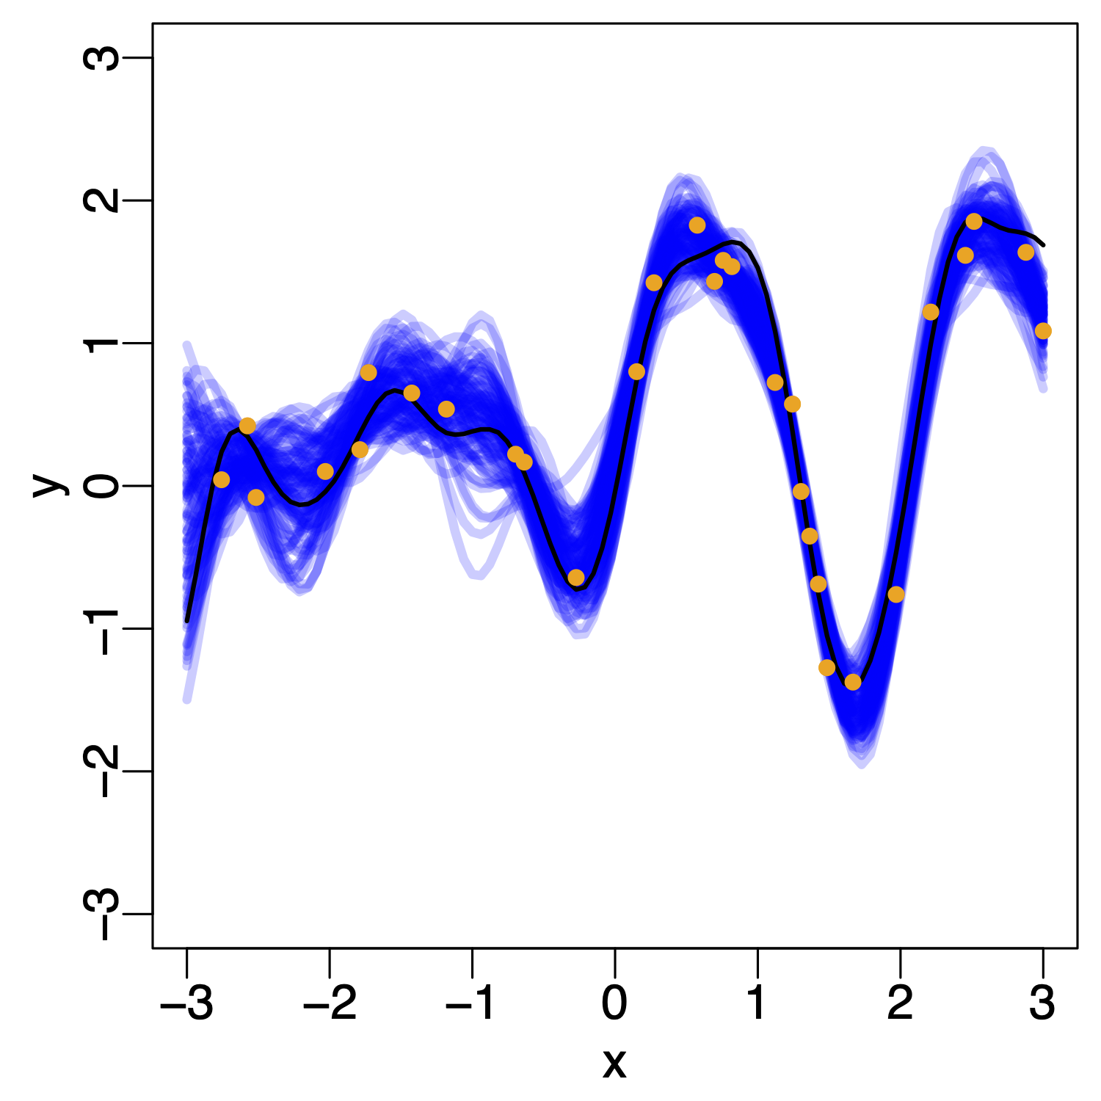
Bayesian Deep Learning
Prof. Maurizio Filippone
https://bdl.kaust.edu.sa
Research areas:
Gaussian processes
Bayesian Deep Learning
Approximate inference
Cheaper and Safer AI:
Good performance with less compute
Reasoning about Uncertainty in AI for assisting decision-making
Knowing when the model doesn’t know
Applications at KAUST:
Impact of grazing on drylands
Grow better tomatoes in the desert
Notes:
The picture on the bottom right shows the extent of the flood that hit KAUST in 2009. One main feature of this extreme event is that it was more extreme than ever recorded in the past in this region, and thus, was unexpected at KAUST. This specific example illustrates the general need to develop statistical models that can predict the probability of future extremes reaching previously unobserved levels. Similarly, the prediction of extremely low rainfall levels is of high importance to assess the risk of droughts (picture on the bottom left). The difficulty of the task resides in the vital need to base any such future extrapolations on theoretically justified arguments, but also in the lack of extreme data (they scarce by definition!), and in the typically highly complex nature of the phenomenon (possibly high-dimensional, spatially correlated, likely non-stationary, etc.). In this work, we propose to a joint model for low, moderate and high rainfall intensities, which does not focus on the largest (or lowest) observations only, but combines all the data into a global model, in order to increase the precision of our parameter estimates, and provide better risk assessment. We showed that the proposed models are not only simple, but can fit very well in practice (figure in the middle).
Naveau, Huser, Ribereau, Hannart (2016, to appear) Modelling jointly low, moderate and heavy rainfall intensities without a threshold selection, Water Resources Research
<number>

Slide 11
Current Students - Highly international
Saudi Arabia
China
Mexico
Colombia
Brazil
France
Italy
Greece
Portugal
Philippines
Kazakhstan
Poland
Morocco
Russia
Tunisia
India
Benin
…

Slide 12
Courses this semester (+grad.seminar)
MSc
  STAT 220: Probability and Statistics
  STAT 230: Linear Models
  AMCS 241: Stochastic Processes
  One more: STAT 215 Applied Statistics with R, or `English’ if you have to
PhD
  STAT 220: Probability and Statistics (*)
  STAT 230: Linear Models (*)
  STAT 250: Stochastic Processes (*)
  One more: STAT 300 Spatial Data Science with R, or STAT 380 Statistics of Extremes ?

Slide 13
But there is more…
Additionally (MSc + PhD) you need to do to STAT398 Graduate Seminar in both semesters!
MSc also need STAT240 Bayesian Statistics in the spring semester.
PhD needs STAT 220/230/250 for their qualifying exam: which is >70% on the final written exam in all courses.
PhD: just register in STAT 220/230/250 and do the course as normal… (recommended)
PhD: Need 4 STAT300 level courses + pass the qualifying exams
In any case, talk to your PI.

Slide 14
MS Statistics: Data Science Track
Additional courses in Computer Science
    Machine Learning/Deep Learning
  Optimization
  Visualization
  Generative modeling
Additional courses in Applied Mathematics
Numerical methods
Mathematical Foundations of Machine/Deep Learning

